Slide 1
邏輯回歸 Logistic regression

Slide 2
對數機率回歸 | 邏輯回歸
Logistic regression | logit regression

Slide 3
Logistic Regression
對數機率回歸（也稱「邏輯回歸」）（英語：Logistic regression 或logit regression），即對數機率模型（英語：Logit model，也譯作「邏輯模型」、「評定模型」、「分類評定模型」）是離散選擇法模型之一，屬於多重變量分析範疇，是社會學、生物統計學、臨床、數量心理學、計量經濟學、市場營銷等統計實證分析的常用方法
https://zh.wikipedia.org/wiki/邏輯迴歸

Slide 4
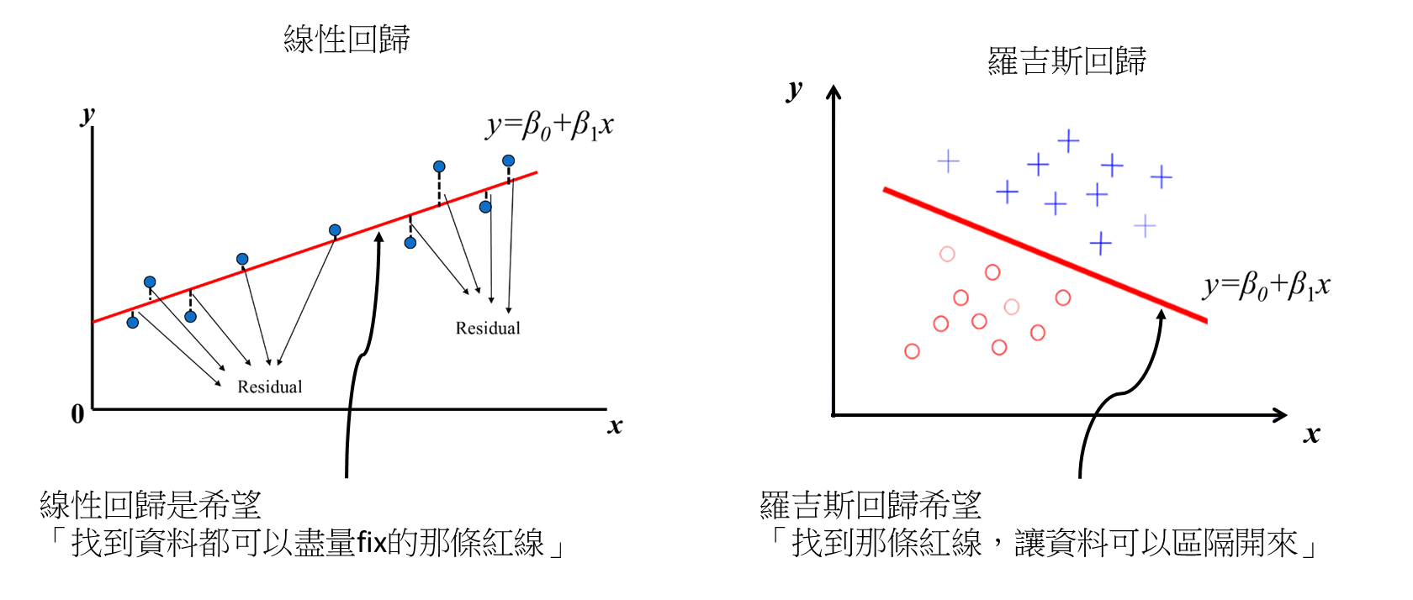
羅吉斯回歸(Logistic regression) VS 線性回歸(Linear regression)
線性回歸是用來預測一個連續的值，羅吉斯回歸是用來分類。

Slide 5

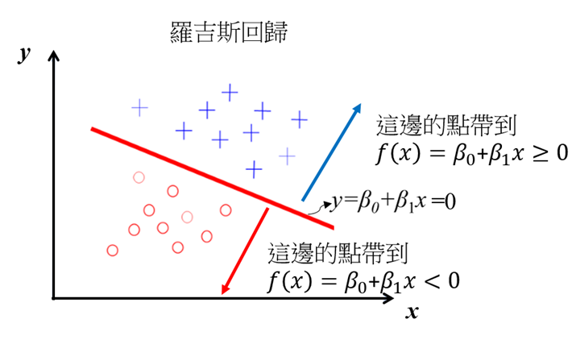
線性回歸輸出是一個連續的實數，
但羅吉斯回歸就是用線性回歸的輸出來判斷這個資料屬不屬於target(二分類問題: target和non-target)
羅吉斯回歸要怎麼做分類?
一個最簡單的概念，將點帶進去回歸線，
回歸線輸出值若是>=0，是一類(target)，
值<0是另一類(non-target)

Slide 6
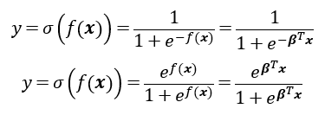
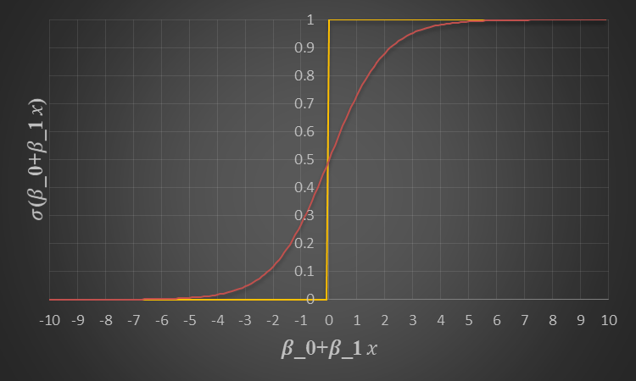
羅吉斯回歸用到的對數函數是Sigmoid函數

Slide 7
如何計算羅吉斯回歸參數(β)?
線性回歸是預測一個數字，
所以我們會希望這個預測值和目標值越接近越好，
所以可以利用最小化平均絕對誤差(Mean Absolute Error, MAE)或是平均平方誤差(Mean Square Error, MSE)來求解。
羅吉斯回歸是用來做分類的，
分類問題在參數型學習(parameter learning)通常都是用最大概似函數估計法 (Maximum Likelihood Estimation, MLE)求解，當然羅吉斯回歸也是
問題??
最大概似函數估計法是估計某一個函數的最大概似量，
羅吉斯回歸是哪種函數?

Slide 8

伯努利分布的機率密度函數(probability density function, pdf)
p:為成功的機率，(1-p):為失敗的機率
當試驗成功時，柏努利的隨機便量等於1(x=1)，
反之試驗失敗柏努利的隨機便量等於0(x=0)

Slide 9

羅吉斯回歸的目標，主要是做二分類問題binary classification
羅吉斯回歸的輸出有兩個，target和non-target機率(也有人說是positive and negative的機率)
機率的輸出最後還是要判斷是不是target(y=1是target，y=0是non-target)
羅吉斯回歸的概似函數就是取伯努利分布的機率密度函數

Slide 10

用「最大概似函數估計法」和「伯努利分布的機率密度函數」對羅吉斯回歸做參數估計
有n組資料，概似函數likelihood為

Slide 11
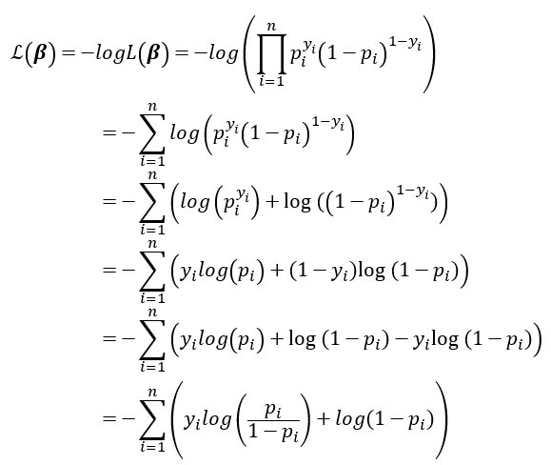
為了簡化針對概似函數取-log，
因為取負號所以最大化概似函數變成最小化對數概似函數，在機器學習稱這個為loglos

Slide 12
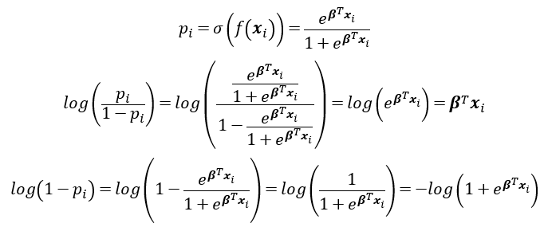

Slide 13
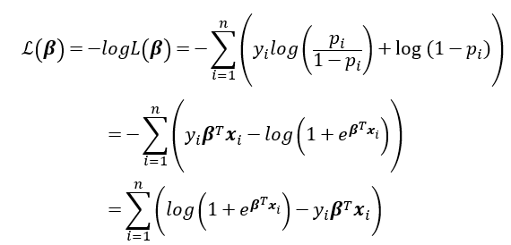

Slide 14
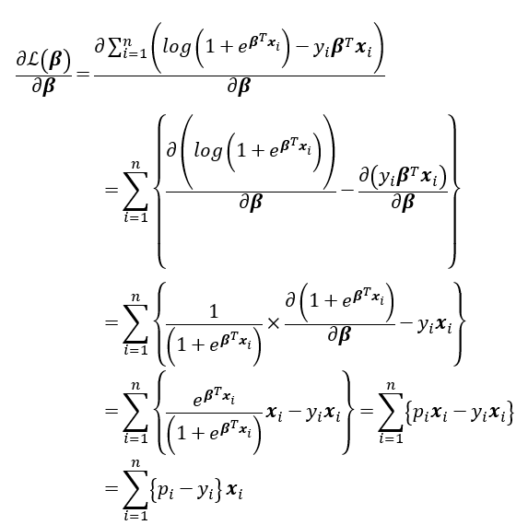
梯度法(偏微分)

Slide 15

α為學習率

Slide 16
Logistic regression 1
https://github.com/zotroneneis/machine_learning_basics/blob/master/k_nearest_neighbour.ipynb

Slide 17
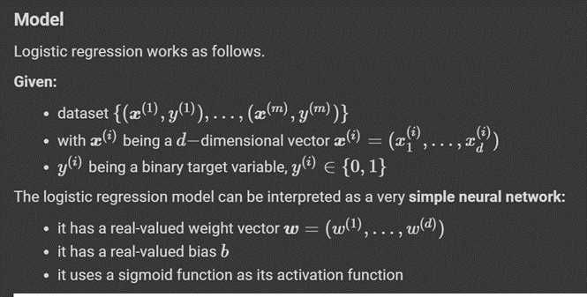
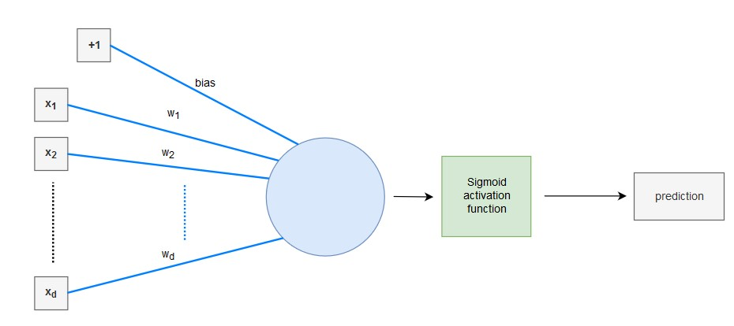

Slide 18
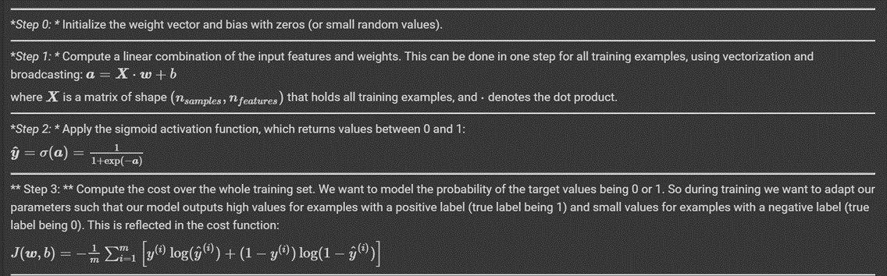

Slide 19
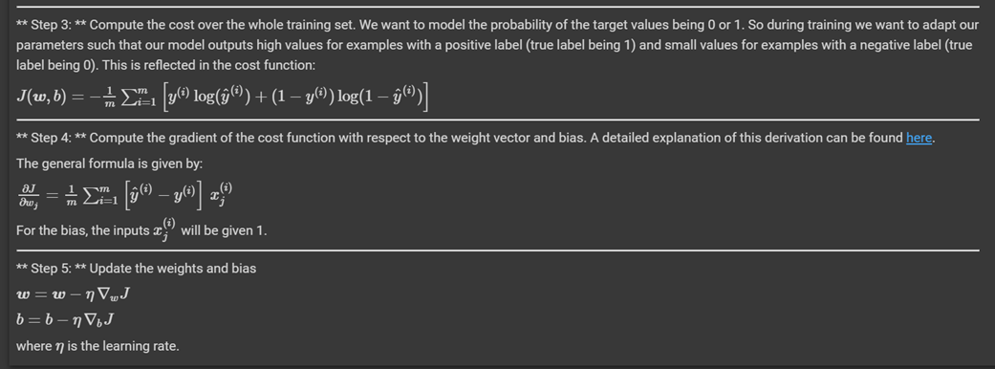

Slide 20
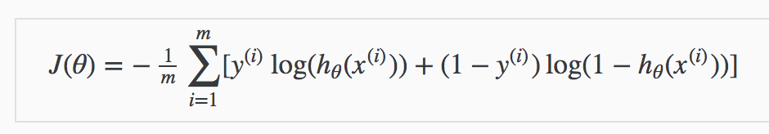
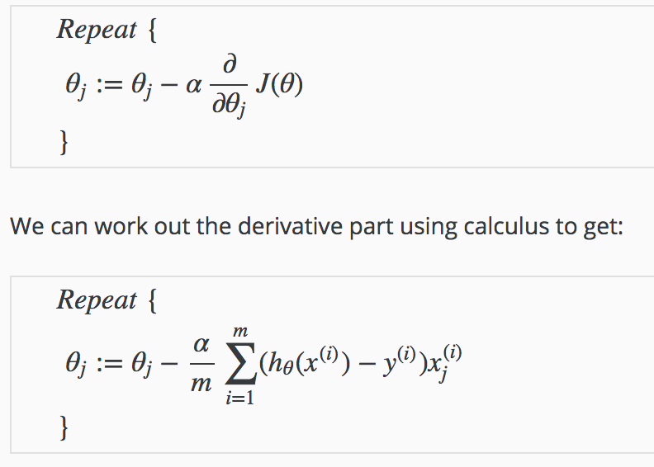
https://stats.stackexchange.com/questions/278771/how-is-the-cost-function-from-logistic-regression-derivated

Slide 21
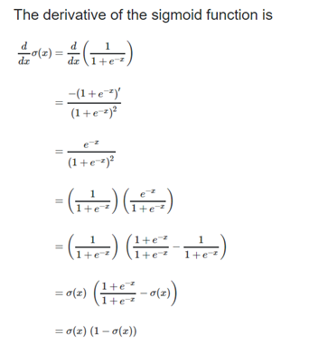

Slide 22
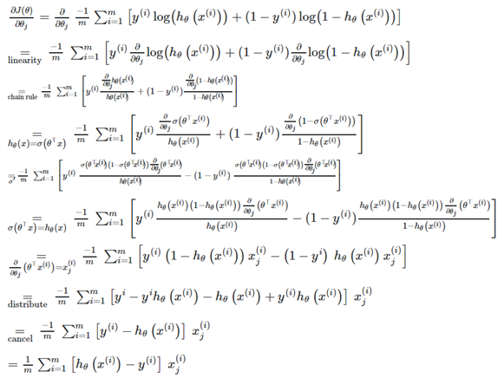

Slide 23
import numpy as np
from sklearn.model_selection import train_test_split
from sklearn.datasets import make_blobs
import matplotlib.pyplot as plt
np.random.seed(123)
% matplotlib inline

Slide 24
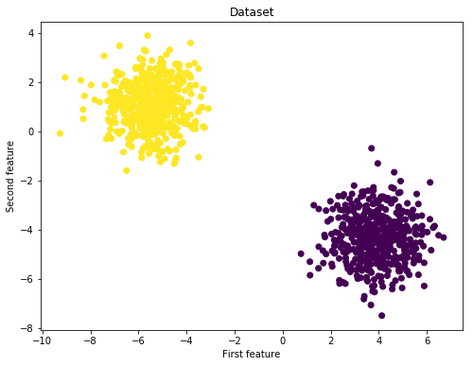
# We will perform logistic regression using a simple toy dataset of two classes
X, y_true = make_blobs(n_samples= 1000, centers=2)
fig = plt.figure(figsize=(8,6))
plt.scatter(X[:,0], X[:,1], c=y_true)
plt.title("Dataset")
plt.xlabel("First feature")
plt.ylabel("Second feature")
plt.show()

Slide 25
# Reshape targets to get column vector with shape (n_samples, 1)
y_true = y_true[:, np.newaxis]
# Split the data into a training and test set
X_train, X_test, y_train, y_test = train_test_split(X, y_true)
print(f'Shape X_train: {X_train.shape}')
print(f'Shape y_train: {y_train.shape}')
print(f'Shape X_test: {X_test.shape}')
print(f'Shape y_test: {y_test.shape}')
Shape X_train: (750, 2)
Shape y_train: (750, 1)
Shape X_test: (250, 2)
Shape y_test: (250, 1)

Slide 26
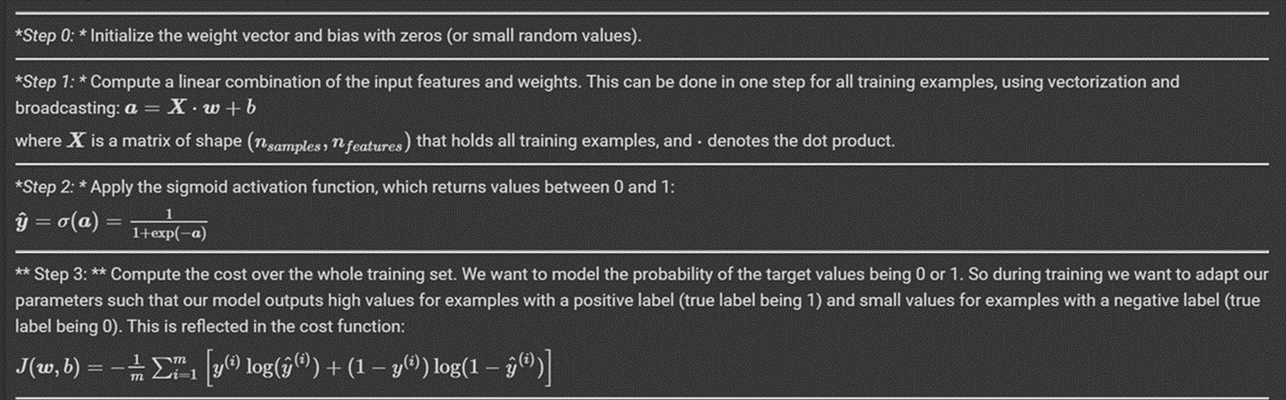
class LogisticRegression:
def __init__(self):
pass
def sigmoid(self, a):
return 1 / (1 + np.exp(-a))
def train(self, X, y_true, n_iters, learning_rate):
"""
Trains the logistic regression model on given data X and targets y
"""
def predict(self, X):
"""
Predicts binary labels for a set of examples X.
"""

Slide 27
def train(self, X, y_true, n_iters, learning_rate):
"""
Trains the logistic regression model on given data X and targets y
"""
# Step 0: Initialize the parameters
n_samples, n_features = X.shape
self.weights = np.zeros((n_features, 1))
self.bias = 0
costs = []
for i in range(n_iters):
# Step 1 and 2: Compute a linear combination of the input features and weights,
# apply the sigmoid activation function
y_predict = self.sigmoid(np.dot(X, self.weights) + self.bias)
# Step 3: Compute the cost over the whole training set.
cost = (- 1 / n_samples) * np.sum(y_true * np.log(y_predict) + (1 - y_true) * (np.log(1 - y_predict)))

Slide 28
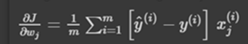
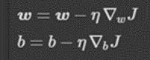
# Step 4: Compute the gradients
dw = (1 / n_samples) * np.dot(X.T, (y_predict - y_true))
db = (1 / n_samples) * np.sum(y_predict - y_true)
# Step 5: Update the parameters
self.weights = self.weights - learning_rate * dw
self.bias = self.bias - learning_rate * db
costs.append(cost)
if i % 100 == 0:
print(f"Cost after iteration {i}: {cost}")
return self.weights, self.bias, costs

Slide 29
def predict(self, X):
"""
Predicts binary labels for a set of examples X.
"""
y_predict = self.sigmoid(np.dot(X, self.weights) + self.bias)
y_predict_labels = [1 if elem > 0.5 else 0 for elem in y_predict]
return np.array(y_predict_labels)[:, np.newaxis]

Slide 30
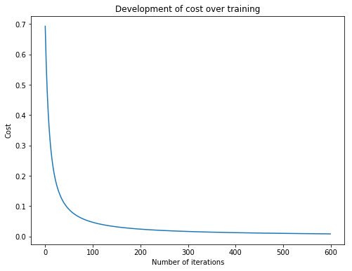
regressor = LogisticRegression()
w_trained, b_trained, costs = regressor.train(X_train, y_train, n_iters=600, learning_rate=0.009)
fig = plt.figure(figsize=(8,6))
plt.plot(np.arange(600), costs)
plt.title("Development of cost over training")
plt.xlabel("Number of iterations")
plt.ylabel("Cost")
plt.show()
Cost after iteration 0: 0.6931471805599453
Cost after iteration 100: 0.046514002935609956
Cost after iteration 200: 0.02405337743999163
Cost after iteration 300: 0.016354408151412207
Cost after iteration 400: 0.012445770521974634
Cost after iteration 500: 0.010073981792906512

Slide 31
y_p_train = regressor.predict(X_train)
y_p_test = regressor.predict(X_test)
print(f"train accuracy: {100 - np.mean(np.abs(y_p_train - y_train)) * 100}%")
print(f"test accuracy: {100 - np.mean(np.abs(y_p_test - y_test))}%")
train accuracy: 100.0%
test accuracy: 100.0%

Slide 32
Logistic regression 2
Sklearn
https://github.com/zotroneneis/machine_learning_basics/blob/master/k_nearest_neighbour.ipynb

Slide 33
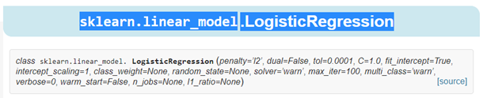
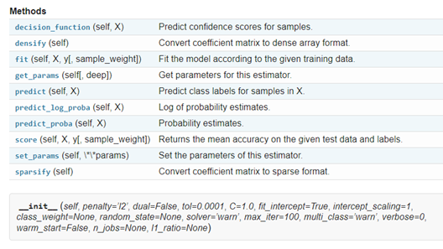
https://scikit-learn.org/stable/modules/generated/sklearn.linear_model.LogisticRegression.html#sklearn.linear_model.LogisticRegression

Slide 34
class sklearn.linear_model.LogisticRegression
(penalty=’l2’, dual=False, tol=0.0001, C=1.0, fit_intercept=True, intercept_scaling=1, class_weight=None, random_state=None, solver=’warn’, max_iter=100, multi_class=’warn’, verbose=0, warm_start=False, n_jobs=None, l1_ratio=None)
https://zhuanlan.zhihu.com/p/35182003

Slide 35
penalty : str, ‘l1’, ‘l2’, ‘elasticnet’ or ‘none’, optional (default=’l2’)
Used to specify the norm used in the penalization.
The ‘newton-cg’, ‘sag’ and ‘lbfgs’ solvers support only l2 penalties.
‘elasticnet’ is only supported by the ‘saga’ solver.
If ‘none’ (not supported by the liblinear solver), no regularization is applied.
New in version 0.19: l1 penalty with SAGA solver (allowing ‘multinomial’ + L1)

Slide 36
solver : str, {‘newton-cg’, ‘lbfgs’, ‘liblinear’, ‘sag’, ‘saga’}, optional (default=’liblinear’).
Algorithm to use in the optimization problem.
For small datasets, ‘liblinear’ is a good choice, whereas ‘sag’ and ‘saga’ are faster for large ones.
For multiclass problems, only ‘newton-cg’, ‘sag’, ‘saga’ and ‘lbfgs’ handle
multinomial loss; ‘liblinear’ is limited to one-versus-rest schemes.
‘newton-cg’, ‘lbfgs’, ‘sag’ and ‘saga’ handle L2 or no penalty
‘liblinear’ and ‘saga’ also handle L1 penalty
‘saga’ also supports ‘elasticnet’ penalty
‘liblinear’ does not handle no penalty
Note that ‘sag’ and ‘saga’ fast convergence is only guaranteed on features with approximately the same scale. You can preprocess the data with a scaler from sklearn.preprocessing.
New in version 0.17: Stochastic Average Gradient descent solver.
New in version 0.19: SAGA solver.
Changed in version 0.20: Default will change from ‘liblinear’ to ‘lbfgs’ in 0.22.

Slide 37
Logistic regression | logit regression
乳腺癌檢測

Slide 38
# -*- coding: utf-8 -*-
%matplotlib inline
import matplotlib.pyplot as plt
import numpy as np
# 載入數據
from sklearn.datasets import load_breast_cancer
cancer = load_breast_cancer()
X = cancer.data
y = cancer.target
print('data shape: {0}; no. positive: {1}; no. negative: {2}'.format(
X.shape, y[y==1].shape[0], y[y==0].shape[0]))
print(cancer.data[0])
cancer.feature_names

Slide 39
from sklearn.model_selection import train_test_split
X_train, X_test, y_train, y_test = train_test_split(X, y, test_size=0.2)
# 模型訓練
from sklearn.linear_model import LogisticRegression
model = LogisticRegression(solver='liblinear')
model.fit(X_train, y_train)
train_score = model.score(X_train, y_train)
test_score = model.score(X_test, y_test)
print('train score: {train_score:.6f}; test score: {test_score:.6f}'.format(
train_score=train_score, test_score=test_score))

Slide 40
# 樣本預測
y_pred = model.predict(X_test)
print('matchs: {0}/{1}'.format(np.equal(y_pred, y_test).sum(), y_test.shape[0]))
# 預測概率：找出低於 90% 概率的樣本個數
y_pred_proba = model.predict_proba(X_test)
print('sample of predict probability: {0}'.format(y_pred_proba[0]))
y_pred_proba_0 = y_pred_proba[:, 0] > 0.1
result = y_pred_proba[y_pred_proba_0]
y_pred_proba_1 = result[:, 1] > 0.1
print(result[y_pred_proba_1])

Slide 41
作業
Logistic regression 2-1
Sklearn
https://www.kaggle.com/mshirlaw/pima-indians-diabetes-simple-logistic-regression

Slide 42
